Slide 1
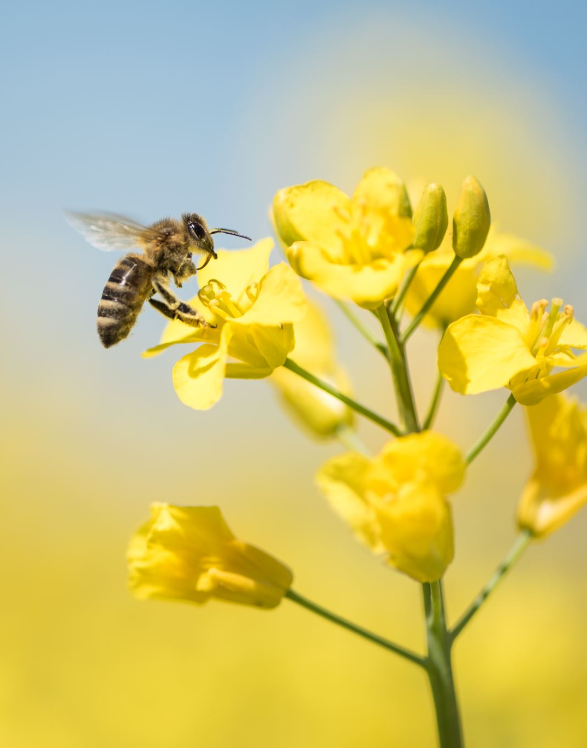
Bee keeping Application project

Slide 2
What is the project of the association??
The project of this association to give the opportunity to women to start a bee keeping small business the women get 80% of the profits and the association get 20% of the profit their production are honey, lip sticks, soap and other natural products made out of honey.

Slide 3
What is the goal of the project??
The goal of the project is to decrease the work time for the association by giving access to send and update photos and massages on the application that we are building instead of them going to the site wasting time and money ,so the women itself can send and update the status of the bee colony saving work and time.

Slide 4
Functional requirements:
The application should be able to store data in a database such as personal information about each colony keeper updates about the colony and some photos of the colony.
The application should allow users to retrieve data from the database so the users can use the data after closing the app.
The application should allow users to update data in the database(updates about the colony photos of the colony and adding a new colony keeper).
The application should allow users to delete data from the database(for admins to delete a colony keeper that stopped working or to delete unnecessary information).
The application should require users to authenticate before accessing the data(every user including admins and checkers must have a username and password so they access the data they are only allowed to access and new users must be accepted only by an admin).

Slide 5
Non-functional requirements:
The application should have robust security measures in place to protect against unauthorized access and data breaches(every user access only his own data and only the admin access the hole data).
The application should be able to handle a large amount of data and perform operations quickly(they have around 300 users right now and saying that the number will decrease to reach 1000 users).
The application should be reliable and not lose data or cause errors.
The application should be user-friendly and easy to navigate(the app might be used by people that are not used to use modern apps like high aged woman ).
The application should be compatible with a range of iOS versions 10.0 and above and for android versions 5.0 and above.

Slide 6
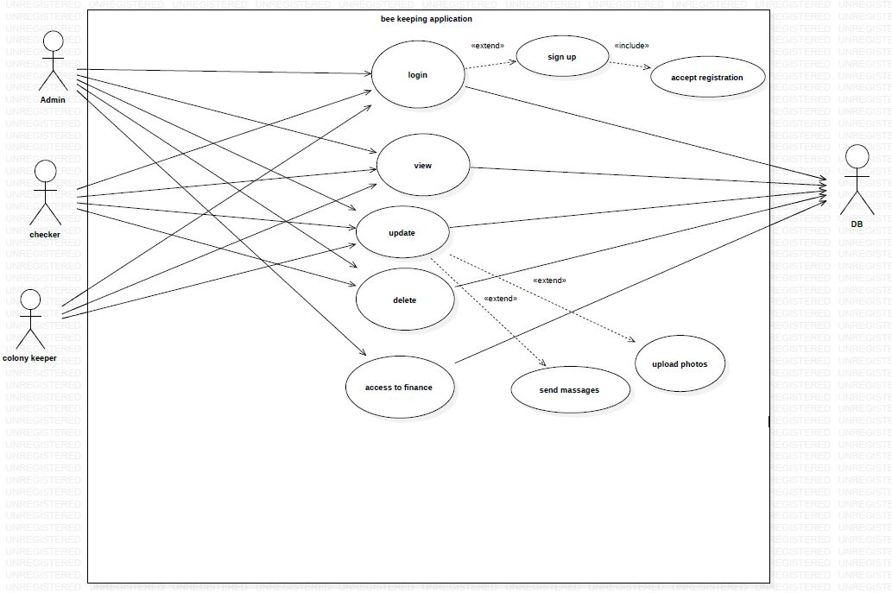
Use cases UML

Slide 7
The End
Amir Ghareeb
Samer Khair
Yousif Hibi

